Slide 1
Regression and Models with Multiple Factors Biology 683 Lecture 6 Heath Blackmon

Slide 2
Last week
Give an example of blocking in your own field.
How can you recognize statistical interaction.
What are a couple of reasons for doing a power analysis?

Slide 3
Today
Regression
Multiple Factors

Slide 4
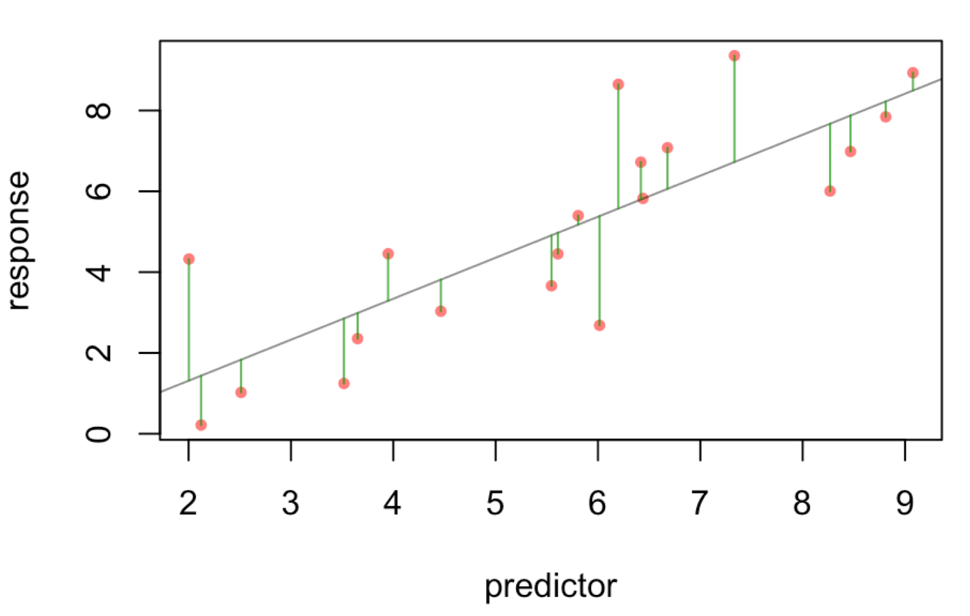
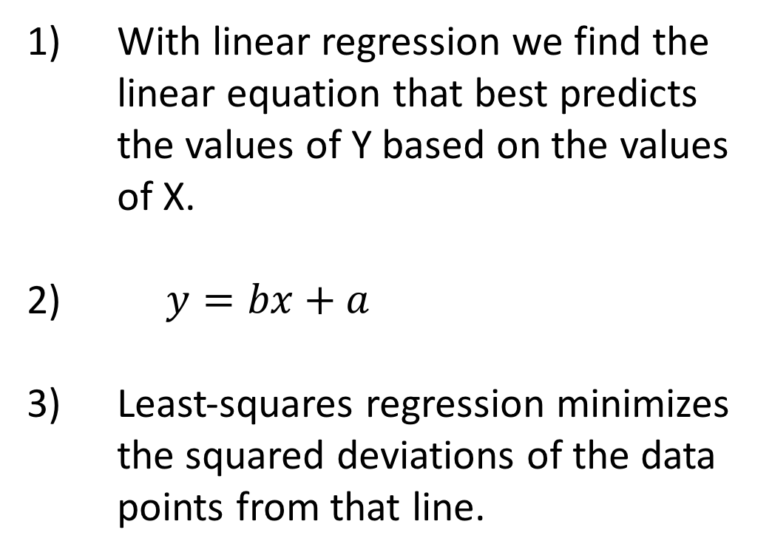
Regression in R
With linear regression we find the linear equation that best predicts the values of Y based on the values of X.
$y=bx+a$
Least-squares regression minimizes the squared deviations of the data points from that line.

Slide 5
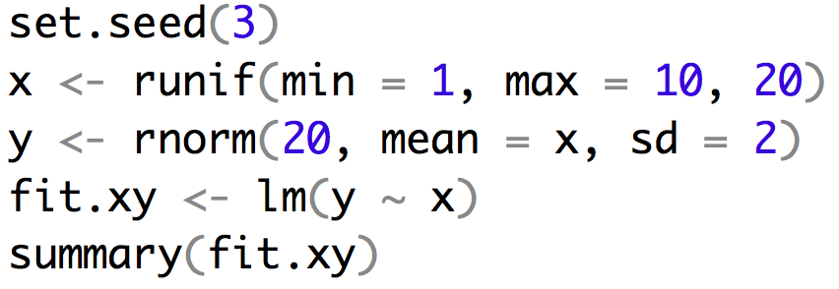
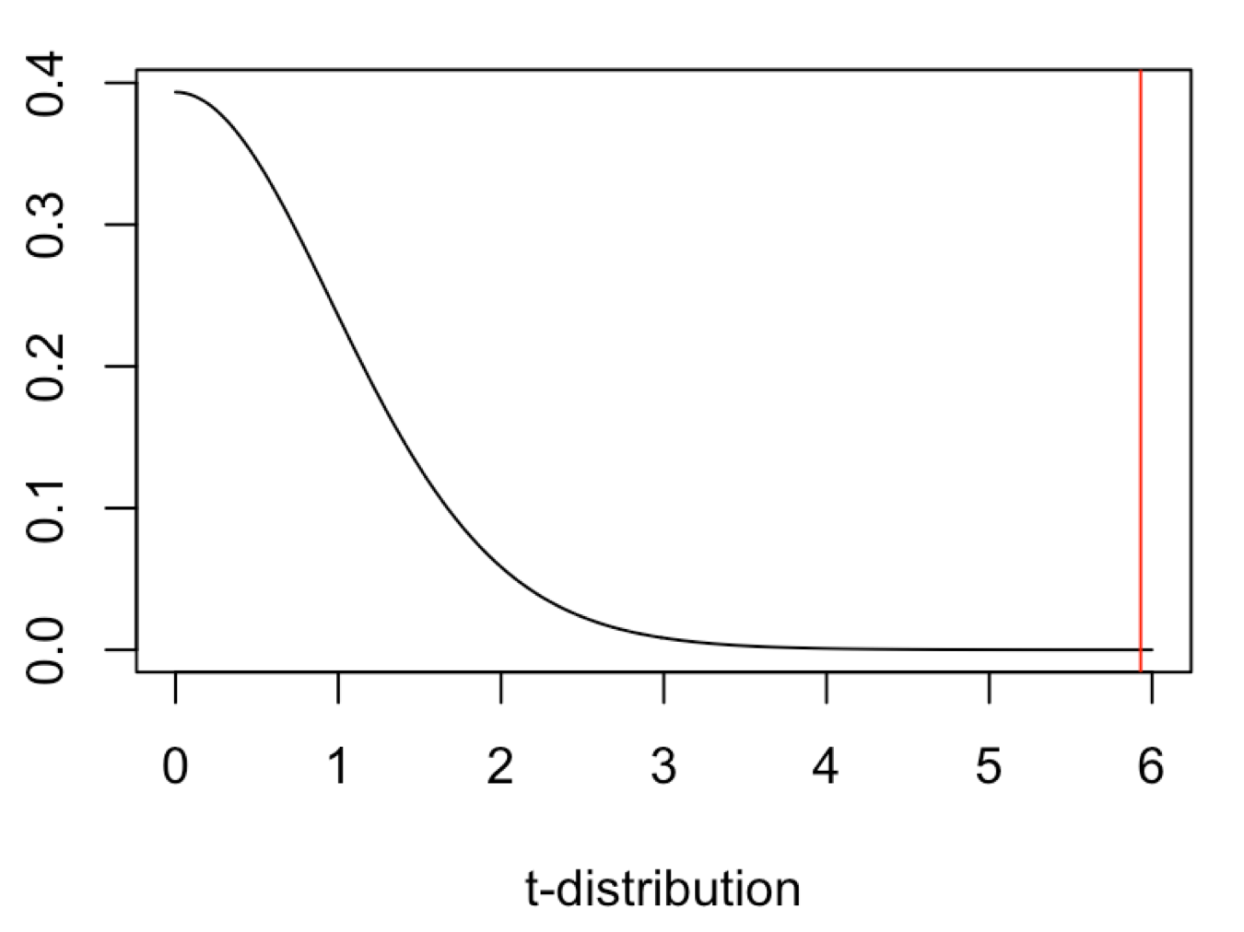
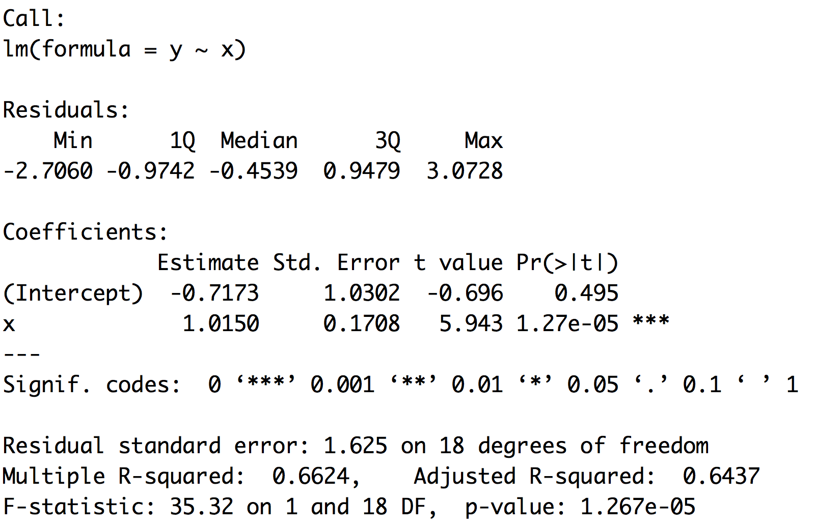
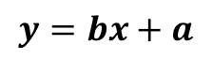
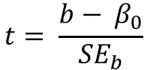
Example of regression
$$y=bx+a$$
$$t= \frac{b− β_{0}}{{SE}_{b}}$$

Slide 6
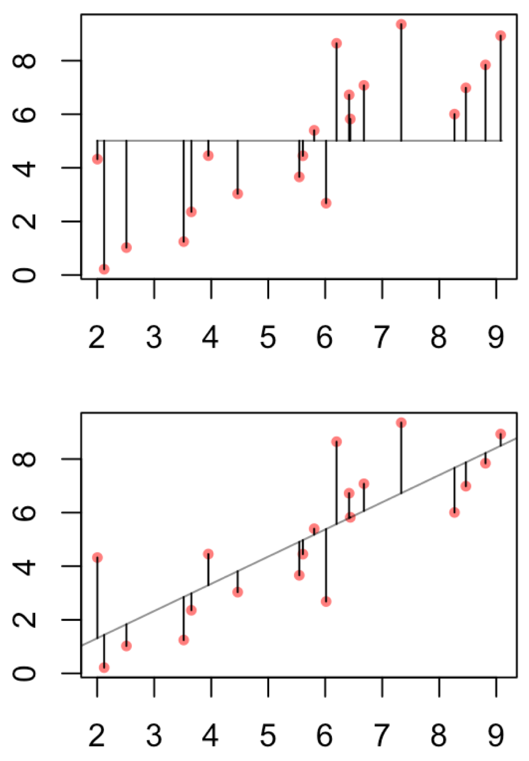
Example of regression
This can help to justify the biological importance
assuming you have a regression that is significant
rather than the statistical

Slide 7
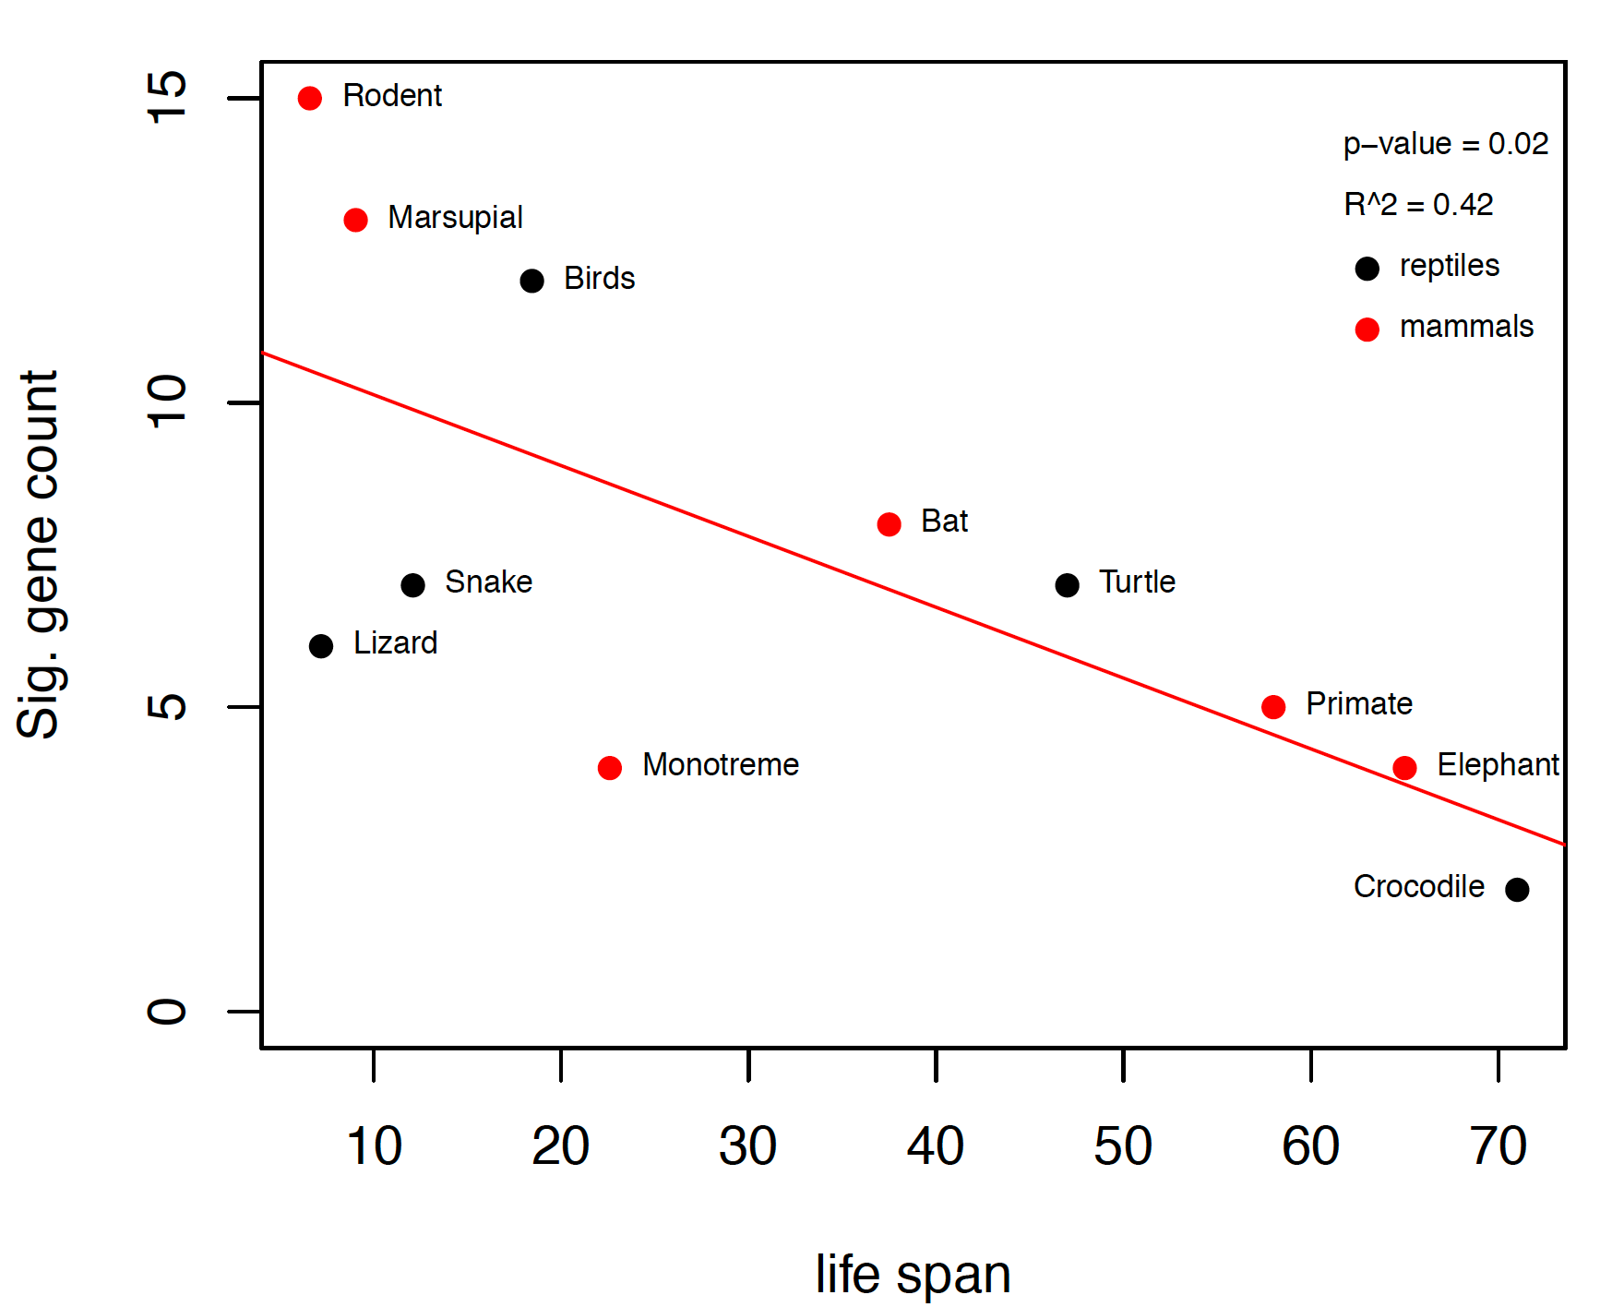
Example of regression
We already know that the P53 network is important in guarding against cancer in long lived species.
So we might think that short lived species would be more likely to experience selection and change in these genes.
What problem might be present with this analysis?

Slide 8
Linear regression uses
Depict the relationship between two variables in an eye-catching fashion
Test the null hypothesis of no association between two variables
The test is whether or not the slope is zero
Predict the average value of variable Y for a group of individuals with a given value of variable X
Note that variation around the line can make it very difficult to predict a value for a given individual with much confidence

Slide 9
What are Residuals
In general, the residual is the individual’s departure from the value predicted by the model
In this case the model is simple – the linear regression – but residuals also exist for more complex models
For a model that fits better, the residuals will be smaller on average
Residuals can be of interest in their own right, because they represent values that have been corrected for relationships that might be obscuring a pattern (e.g., the body weight-testes mass relationship)

Slide 10
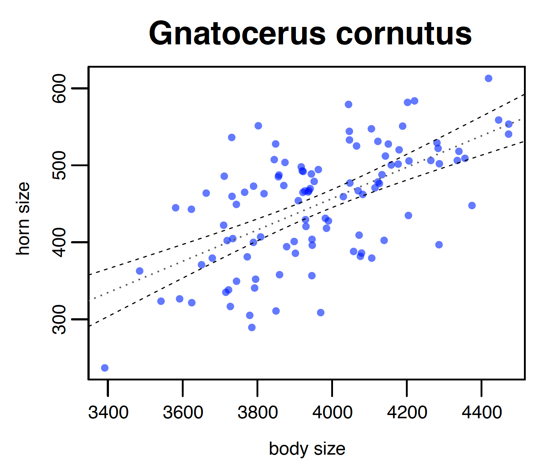
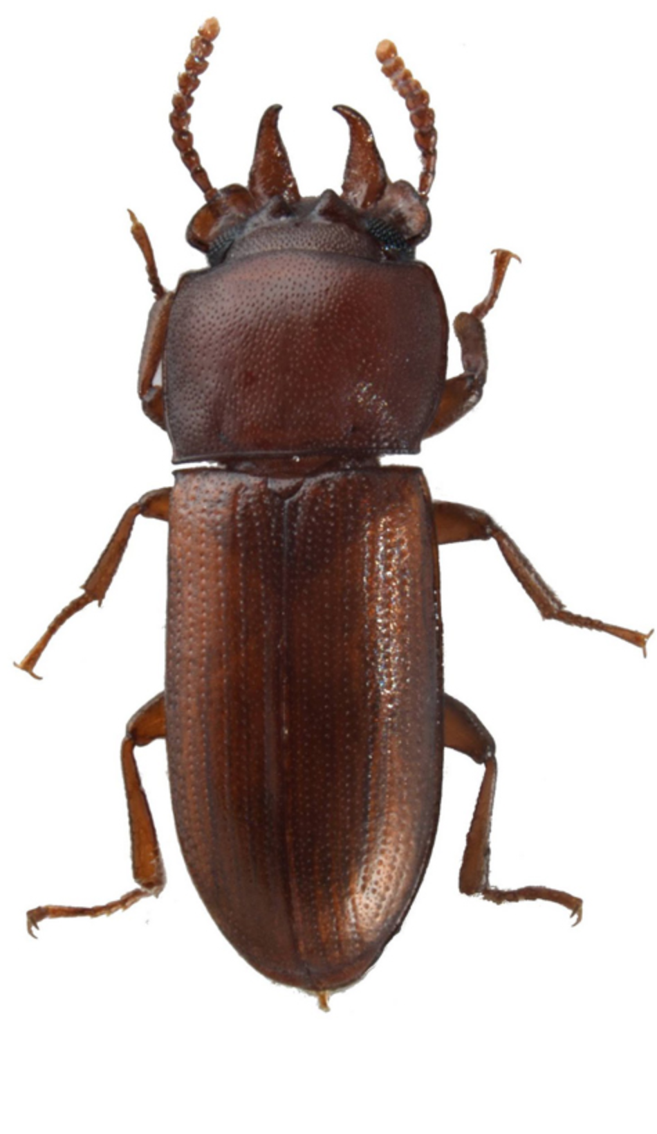
What are Residuals
Horn Size
Body Size

Slide 11
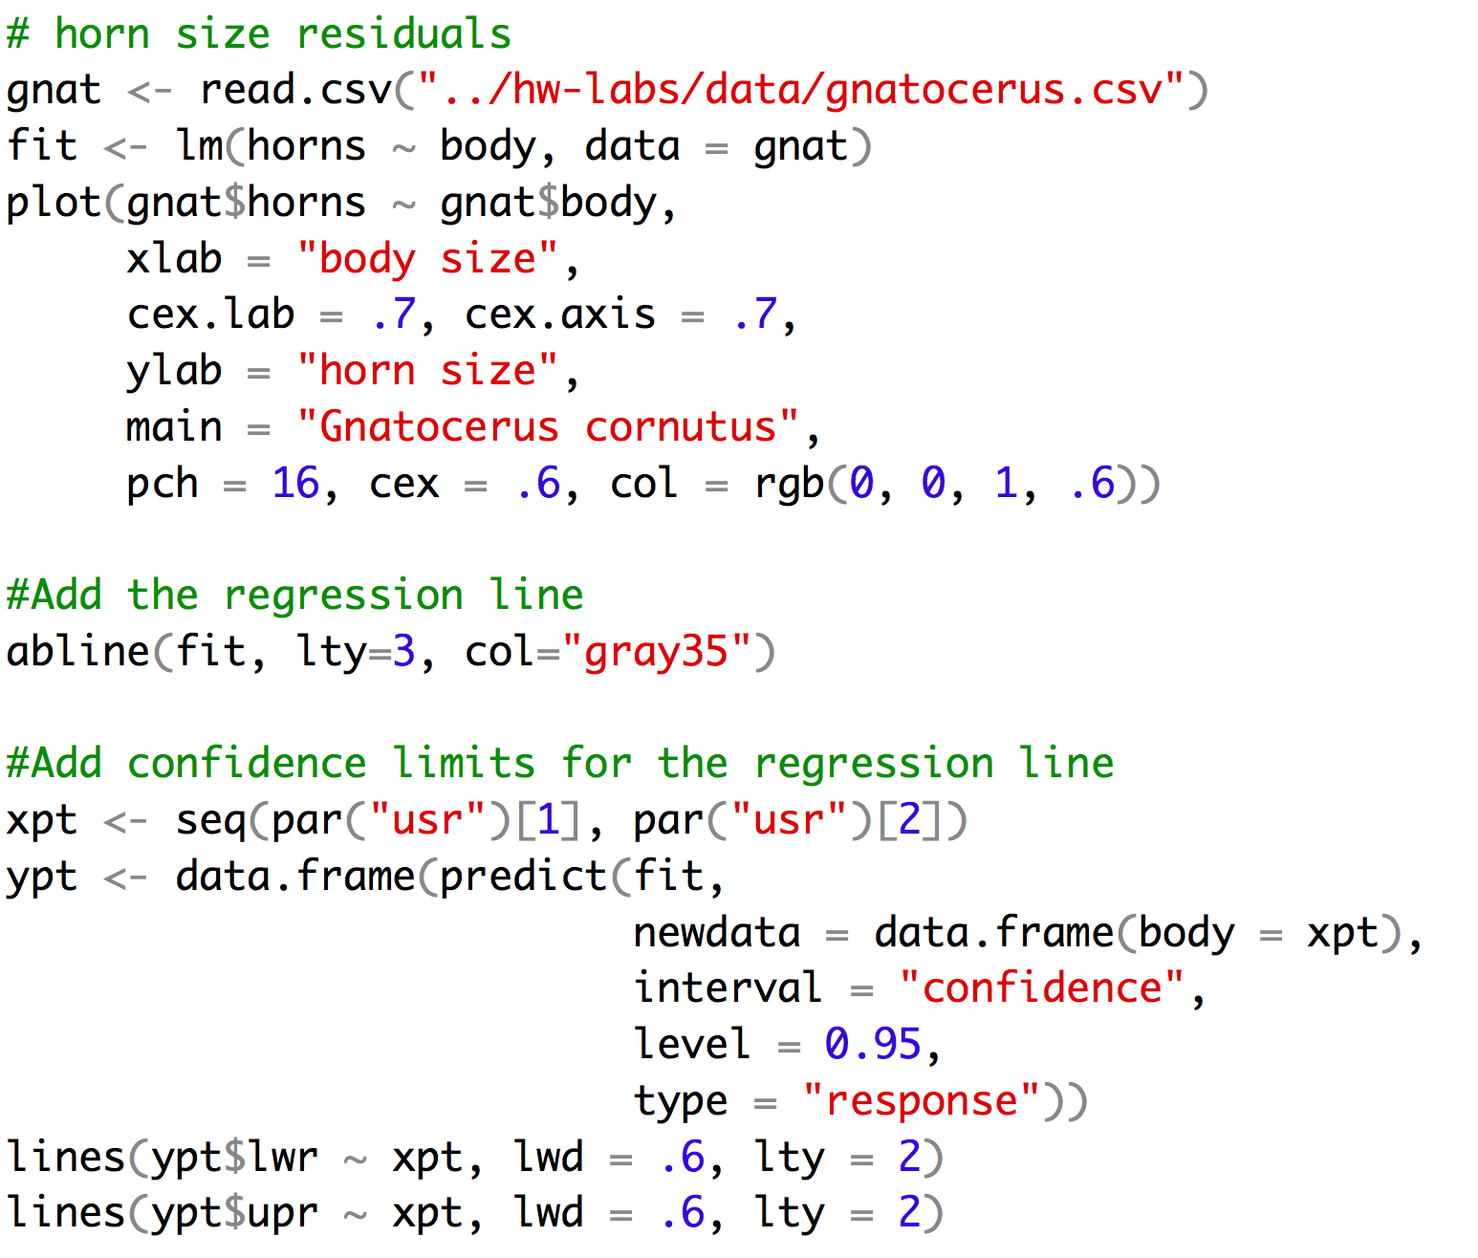
Making that plot

Slide 12
Strong Inference for Observational Studies
Noticing a pattern in the data and reporting it represents a post hoc analysis
This is not hypothesis testing
The results, while potentially important, must be interpreted cautiously
What can be done?
Based on a post-hoc observational study, construct a new hypothesis for a novel group or system that has not yet been studied
For example, given the primate data, a reasonable prediction is that residual testes mass in deer will be associated with mating system
Collect a new observational data set from the new group to test the hypothesis

Slide 13
Assumptions of Linear Regression
The true relationship must be linear
At each value of X, the distribution of Y is normal (i.e., the residuals are normal)
The variance in Y is independent of the value of X
Note that there are no assumptions about the distribution of X

Slide 14
Common Problems
Outliers
Regression is extremely sensitive to outliers
The line will be drawn to outliers, especially along the x-axis
Consider performing the regression with and without outliers
Non-linearity
Best way to notice is by visually inspecting the plot and the line fit
Try a transformation to get linearity [often a log transformation]
Non-normality of residuals
Can be detected from a residual plot
Possibly solved with a transformation
Unequal variance
Usually visible from a scatterplot or from a residual plot

Slide 15
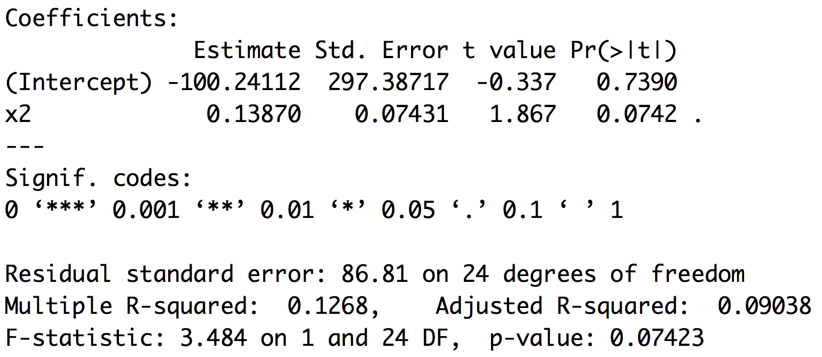
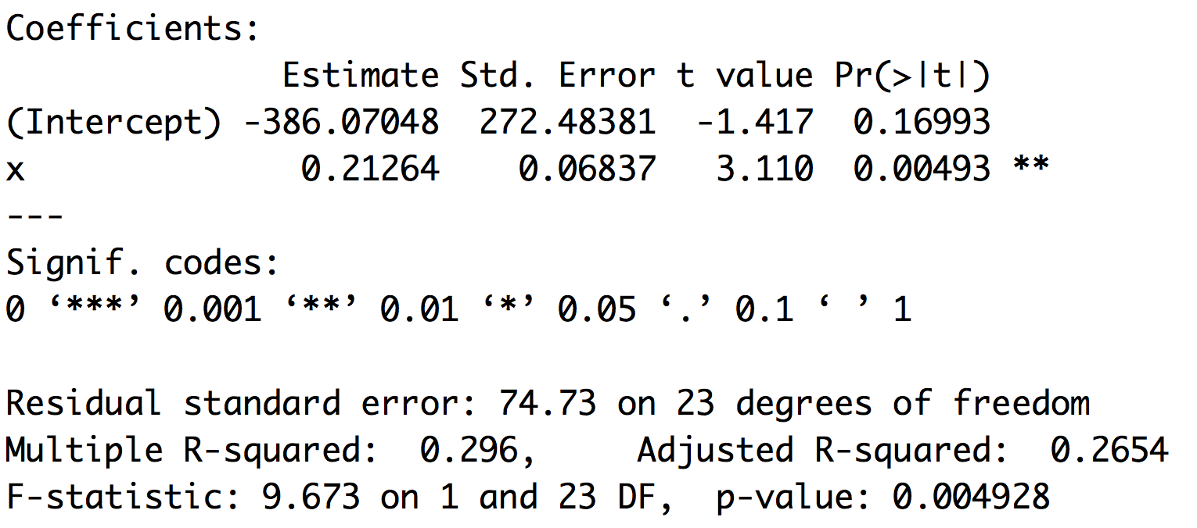
Outliers
Leverage and cooks distance

Slide 16
Residual plots

Slide 17
Multiple Explanatory Variables
The reason ANOVA is so widely used is that it provides a framework to simultaneously test the effects of multiple factors
ANOVA also makes it possible to detect interactions among the factors
ANOVA is a special case of a general linear model

Slide 18
General Linear Models
GLMs handle categorical factors and continuous factors in a single modeling framework
ANOVA is a special case with just categorical explanatory variables
Linear regression is a special case with just continuous explanatory variables

Slide 19
Analysis of Covariance
Used to test for a difference in means, while correcting for a variable that is correlated with the response variable
The slopes must not differ in the two groups
In other words, the mean comparison is only valid if the interaction term is not significant
Also used to compare the slope of two regression lines
If the interaction term is significant, then the conclusion is that the slopes are different

Slide 20
Summary
Statistical models can be quite complex, with potentially many factors and interaction terms
The model is specified by something that looks like an equation: Y = μ + A + B + A*B
General linear models allow you to combine categorical and continuous factors into a single model
Your sample size will limit the complexity of the model
You will need to think about how you choose the model you estimated under (single model/model averaging)

Slide 21
For Thursday
Read chapter WS 6-9
Bring laptop to class!
Heath Blackmon
BSBW 309
coleoguy@gmail.com
@coleoguy

